Slide 1

Microsoft Industry Specific Solution
Team name - Tailorbird
Team Leader – Aditya Kumar

Slide 2
Problem Statement
Overall, the fashion industry is responsible for 8-10% of global emissions, according to the UN - more than the aviation and shipping combined.
According to the basic trend, Fabric manufactures produce 113 million metric tons of Fabric every year.

Slide 3

Solution - Tailorbird
Tailorbird is a disruptive Ecommerce APP and Website, which allows you to choose your desired clothes from the vide variety of designs available or also you can customize your dress too.
After that you can select your specific size from our size chart or also you can enter your custom size manually else you can upload your photography for the size.
And Yippee!!
Your order will be delivered to your door step shortly!
Tailorbird eliminates the excessive production of garments in the market by providing the design online and only ordered amount of clothes will be stitched.
We can reduce production of clothes and fabrics which will decrease the amount of global emission.

Slide 4
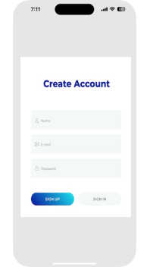
1.Login into Tailorbird APP or Website
Open the tailor bird app
Enter your Phone number.
Email Address
Address
Bank Details
Etc.

Slide 5
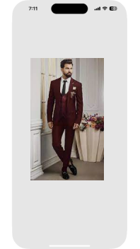
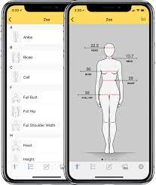
Select your desired Cloth
Select from the wide range of cloth design.
Select your favorite color, style and any other specification.
Enter your specific body size or enter the size manually.
Also, you can upload your picture for sizing.
We will deliver your stitched clothes to your doorstep ASAP.

Slide 6
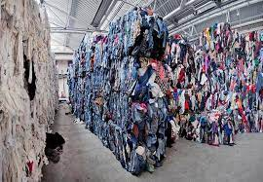
Reduce carbon emission
Companies and Factories which are making fabrics and clothes in bulk are using high amount of chemicals and dump the waste in oceans and rivers which contribute 8-10 percent of the global warming.
Moreover they are using high amount of energy resources to produce fabrics.
Only required amount of clothes and fabric is produced. Hence lead to low globar warming.

Slide 7
Use Azure and Data analysis tools
We can use Microsoft Cloud to manage the entire business process smoothly.
Also, we can use data analysis tools to predict the amount of fabrics and designs to produce in the next interval of time

Slide 8
Microsoft sustainability Manager
Use to record emission footprints of waste and helps to reduce it by tracking it.
Use emission impact dashboard for smooth functioning.
Recycle, re-commerce and reuse tracking.
Tracking of material and goods all over the world.

